Slide 1
Squash Bugs and Improve Code Quality
Leslie Richardson
Program Manager
VS Debugging & Diagnostics
@lyrichardson01

Slide 2
Debugger Performance Updates
Most VS windows are now async (i.e. watch, call stack)
UI delays in most windows down by 70%
Stepping block time is down by more than half compared to VS 2017
C++ Out-of-Proc → 84% memory reduction for devenv.exe
Notes:
-- promote empathy regarding perf

Slide 3

Notes:
--talk about nat jmc file – says what the rules are for counting stuff considered “just my code” When I double-click I expect to see something open and show the whole string

Slide 4
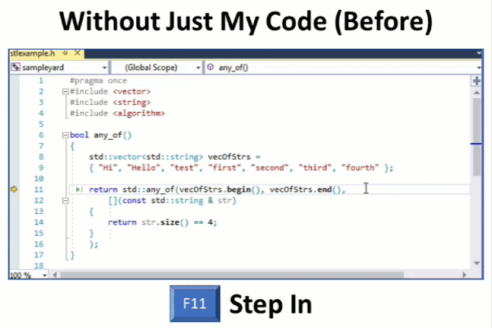
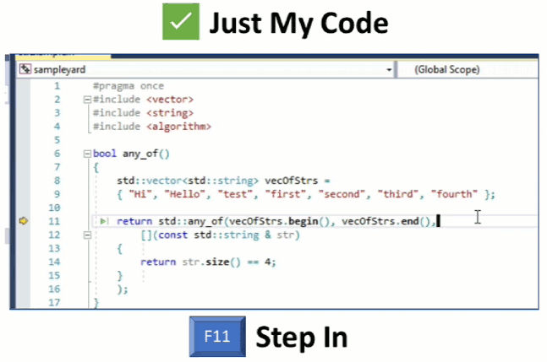
Just My Code for C++
Notes:
--talk about nat jmc file – says what the rules are for counting stuff considered “just my code” When I double-click I expect to see something open and show the whole string
--framework code = third-party code
--don’t have to think about whether to step into a function or not → reducing

Slide 5
Just My Code for C++ - .natjmc file format
<?xml version="1.0" encoding="utf-8"?>
<NonUserCode xmlns="http://schemas.microsoft.com/vstudio/debugger/jmc/2015">
<!-- Modules -->
<Module Name="ModuleSpec" />
<Module Name="ModuleSpec" Company="CompanyName" />
<!-- Files -->
<File Name="FileSpec"/>
<!-- Functions -->
<Function Name="FunctionSpec" />
<Function Name="FunctionSpec" Module ="ModuleSpec" />
<Function Name="FunctionSpec" Module ="ModuleSpec" ExceptionImplementation="true" />
</NonUserCode>
Notes:
--talk about nat jmc file – says what the rules are for counting stuff considered “just my code” When I double-click I expect to see something open and show the whole string
--JMC - can enable if you are debugging code written by other team mates and you want to automatically step over it because their code isn’t relevant to you

Slide 6
Demos

Slide 7
Questions?

Slide 8
Demos Repo tailored for .NET Core 2.2: https://github.com/leslierichardson95/ReadingList Repo tailored for .NET Core 3.0: https://github.com/leslierichardson95/reading-list

